Slide 1
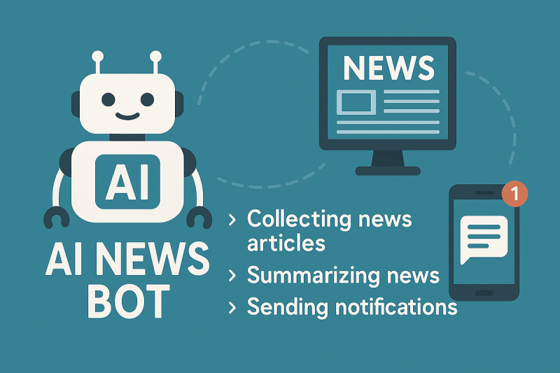
News Bot 2.0
By: Miguelangel Sanchez-Yevenes Kaden Glover

Slide 2

NewsBot 2 - Summary NewsBot 2 is a next-generation AI system designed to fetch, categorize, and summarize news in real time.
It combines machine learning, natural language processing, and a conversational interface to deliver relevant news faster. This presentation covers the system demo, technical overview, and business impact.​ We went over different sections and add in our codes and also key questions that should be answered.

Slide 3
Countless platforms publish millions of articles daily. Readers frequently spend time sifting through irrelevant articles before locating what is significant to them. NewsBot 2 addresses this issue by filtering, classifying, and summarizing news in real time.
Our solution is:
From gathering news to giving the final result, our technology does all the work automatically.
It makes sharing information faster by removing extra details, sorting stories by keywords, and creating short summaries.
With the chat feature, people can ask for updates in a simple, natural way and get answers right away.

Slide 4
Section 1 - Project Setup & Architecture Planning This code imports all the libraries required for data processing, machine learning, deep learning, and visualization, setting up the entire ecosystem for creating NewsBot 2.0.
It has online scraping and translation features in addition to tools for text cleaning, categorization, sentiment analysis, clustering, and summarization.
After the setup is complete, the system is ready to manage all phases of the news-processing pipeline, from collecting articles to producing well-written summaries.

Slide 5
Demo Workflow:
A standard workflow begins when a user types in a query, like "Show me tech news." After retrieving relevant articles, the bot preprocesses them using natural language processing and classifies them. Lastly, the user is given conversational summaries that have been generated.​ The output should include an article with a brief summary, giving users the key points without reading the full text. Thus making this a better experience for the user.

Slide 6
Section 2 - Advanced Content Analysis Engine
This class creates an effective news classifier that can learn from labeled articles, forecast their category using confidence ratings, and identify the terms that had the biggest impact on the classifier's choice.​
Using a technique known as LDA, the TopicDiscoveryEngine searches through a large number of articles to identify recurring themes or subjects. It then displays the key terms associated with each topic and has the ability to create word clouds for them.
The SentimentEvolutionTracker examines emotions like joy and rage as well as how readers feel about news stories with a positive, negative, or neutral tone.
It can monitor the evolution of these emotions over time and even identify abrupt changes in mood that could indicate a significant event.

Slide 7
Data Pipeline: News articles from APIs and live feeds first go through a cleanup process that removes extra stuff we don’t need, like ads or random formatting. Then the system breaks the text into smaller pieces and figures out important names, places, and events so it understands what each story is about. This clean and organized information is then used to sort the articles into topics and make short summaries to make it easier to read. The system sorts articles into different topics by looking for certain keywords and understanding what the article is mainly about. To make summaries, it picks out the most important sentences so you get the main idea without reading the whole thing.

Slide 8
Section 3 - Language Understanding & Generation
The system learns to comprehend the content of an article and provide a clearer explanation.
By taking the most crucial details and re-wording them in its own words, it may produce succinct summaries.
Additionally, it is able to do meaning-based search, meaning that you can type a query exactly as you would, and it would still identify the appropriate articles.
Lastly, it checks that the output it generates is accurate and logical before showing it to you.
​

Slide 9
Code Structure:
The code is split into clear sections called classes, each with its own job.
Advanced News Classifier sorts articles into the right categories, while Conversational Interface handles talking with the user.
NewsBot Integrated System brings everything together so the whole program works as one.
This setup makes it easier to grow the system and fix problems when they come up.

Slide 10
Conversational Interface​: The system's conversational component is made to infer the user's true desires, even if they are not expressed explicitly.
It can identify key information in a question, such as names, dates, or subjects, and record the dialogue so it can recall previous exchanges.
It will ask follow-up questions to ensure it receives the correct response if a question is not obvious.
All of this makes the communication seem more natural, flow more easily, and function more like speaking with a human than a computer.

Slide 11
Section 4 - Multilingual Intelligence The ability to successfully comprehend and use multiple languages, whether by humans or artificial systems, is known as multilingual intelligence. It makes cross-cultural and cross-regional communication, learning, and problem-solving easier. This part of the code is all about handling different languages.
It can figure out what language a piece of text is written in and how confident it is about that guess.
It can also translate the text into another language, compare how much content there is in different languages, and spot cultural references like festivals or traditions.
Basically, it makes the system able to work with news from around the world, no matter the language.

Slide 12
Section 5 - Conversational Interface This code creates an intelligent chatbot that can naturally discuss news. It determines the user's preferences (such as searching, summarizing, or comparing news), extracts pertinent information from the query (such as subjects, dates, or mood), and provides a useful answer.
In order to better respond to follow-up questions, it even retains previous inquiries. It finds key details in the user's question, like topics, timeframes, or emotions, and gives a clear, helpful response. It also remembers the last question so it can handle follow-up questions easily.

Slide 13
Section 6 - System Integration & Testing The NewsBot system's components are combined in this code to create a potent tool that can read, comprehend, and evaluate news articles.
It can identify the article's main topic, tone, and key characters before summarizing or reporting on its findings. A testing system is also included to ensure that everything functions as intended. It can handle one article or many at once and give different types of reports, like summaries or trends. The testing part helps make sure the system is fast and accurate even with hard or strange inputs.

Slide 14
Section 7 - Evaluation & Documentation This code assesses the NewsBot 2.0 system's performance in a number of domains, including user experience, topic modeling, classification, and summarization.
It computes important metrics like recall, accuracy, precision, and F1 score and uses a confusion matrix to display the results. The evaluations for topics, summaries, and UX are fictitious examples with placeholder values, but the classification is based on actual inputs.
Lastly, it offers a summary report that identifies areas for improvement, highlights system strengths, and makes recommendations for future actions.

Slide 15
NewsBot 2 converses with users interactively, in contrast to static news aggregators.
Challenges included; More sophisticated language models could improve on the summarization techniques currently in use. Systems still struggle to comprehend news articles' subtle meanings, bias, and sarcasm.
Potential future enhancements could include voice interaction, multilingual support, and enhanced sentiment analysis.

Slide 16
Conclusion: Using Natural Language Processing (NLP) techniques, the NewsBot2 project effectively illustrates the creation of an end-to-end automated system for gathering, processing, and evaluating news articles. The core of the project involves implementing advanced NLP models and classifiers to categorize news articles by topics and sentiments to users for better experience. NewsBot2 is a prime example of how raw news data can be converted into useful intelligence using contemporary NLP pipelines. A flexible tool for automated news analysis, the NewsBot2 framework supports applications in media monitoring.

